Slide 1
Facial Emotion Recognition Using ResNet50
Submitted by: K.V.V. ABHINAV

Slide 2
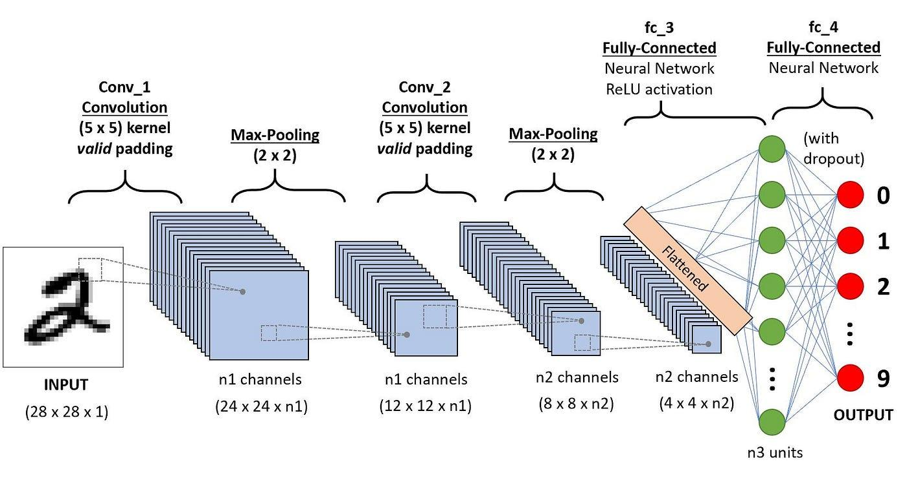
Project Overview
Developed a deep learning pipeline for Facial Emotion Recognition.
Utilized transfer learning with the ResNet50 architecture.
Trained and evaluated on the FER2013 Kaggle dataset of labeled grayscale facial images.
Applied image preprocessing and data augmentation to improve model generalization.
Performance evaluated using:
Accuracy & loss curves
Confusion matrix
Classification report

Slide 3
Dataset Exploration
In this exploration, several datasets were considered for analysis. The FER2013 (Kaggle) dataset consists of 48x48 grayscale images representing 7 emotions. It is noted for being easy to preprocess, making it a favorable choice for many projects.
Another dataset reviewed was the CK+ Dataset, which has a limited size and is mostly used for benchmarking purposes. In contrast, the AffectNet dataset is described as very large and rich, but it requires extensive preprocessing, which can be a drawback for some applications.
Ultimately, the final choice was the FER2013 dataset from Kaggle. It is well-labeled, balanced enough, and easy to integrate into initial and intermediate deep learning pipelines. The dataset can be accessed through the FER2013 Dataset URL.

Slide 4
Dataset Exploration
🔍 Explored Datasets:
FER2013 (Kaggle):
48x48 grayscale images
7 emotions
Easy to preprocess
CK+ Dataset:
Limited size
Mostly used for benchmarking
Dataset URL: https://www.kaggle.com/datasets/tapakah68/facial-emotion-recognition
3. AffectNet:
Very large and rich
Required extensive preprocessing
✅ Final Choice:
FER2013 from Kaggle:
Well-labeled, balanced enough, easy to integrate
Suited for initial and intermediate deep learning pipelines

Slide 5
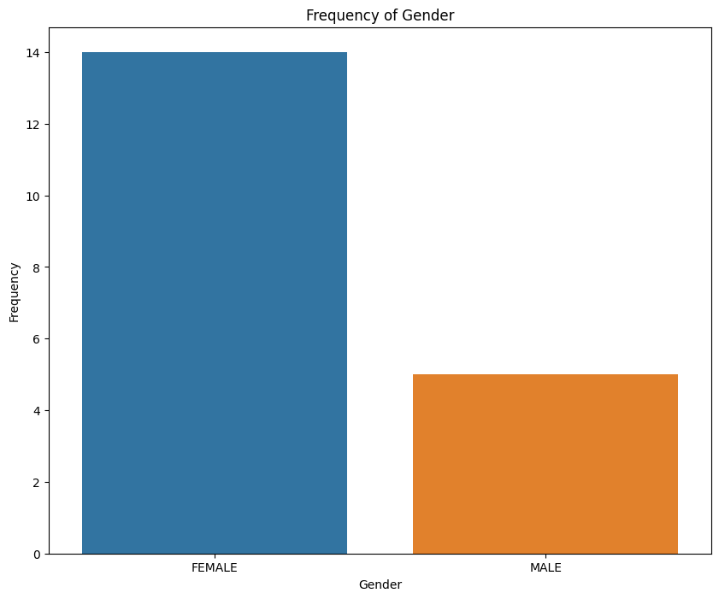
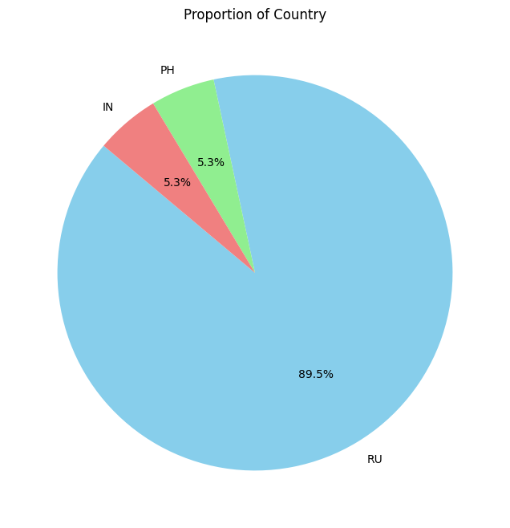
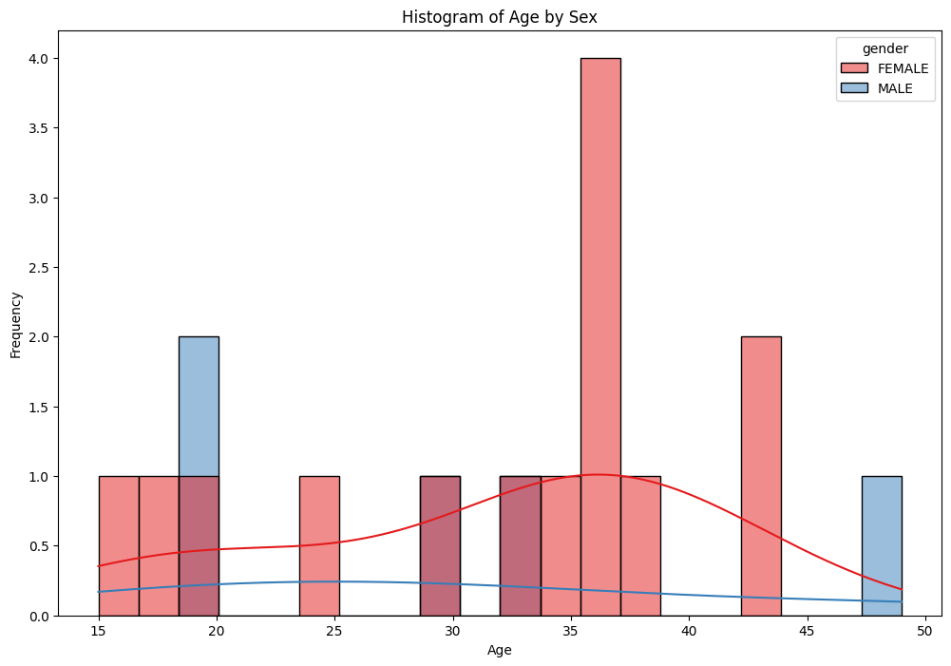
Exploratory Data Analysis (EDA)

Slide 6
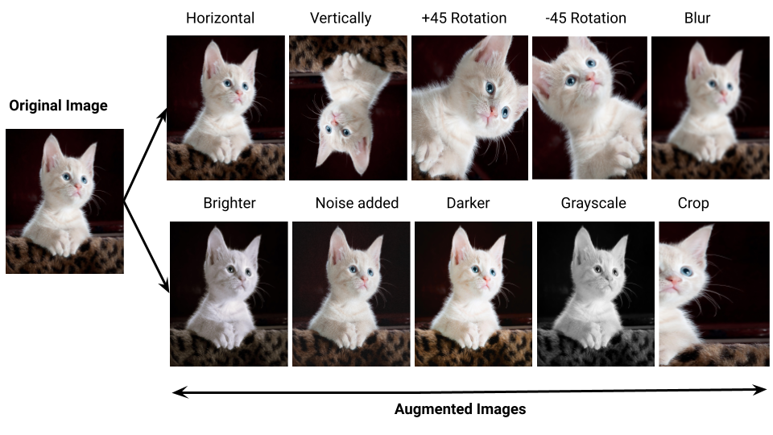
Data Preprocessing and Augmentation
Steps Involved:
Resizing all images to (224x224) Normalization of pixel values One-hot encoding of categorical labels
Data Augmentation Techniques used:
Random rotation Horizontal flipping Zooming
Insight:
Augmentation helps prevent overfitting and makes the model robust to minor facial variations.

Slide 7
Models Explored and Final Choice
VGG16 / VGG19
Pros: Simple, widely used, deep architecture
Cons: Large number of parameters, slower training, prone to overfitting on small datasets
MobileNetV2
Pros: Lightweight, mobile-friendly, fast training
Cons: Slightly lower accuracy for subtle emotion detection
DenseNet121
Pros: Feature reuse, efficient gradients
Cons: Complex connections, longer training time
EfficientNetB0
Pros: Scales well with fewer parameters
Cons: Requires fine-tuning and longer convergence
Why ResNet50?
Residual Connections solve vanishing gradient problems in deep networks
Balanced trade-off between depth and training efficiency
Pretrained on ImageNet, excellent at extracting general image features
Showed better validation accuracy and generalization during experiments
Easier to fine-tune for emotion classification compared to heavier or shallower models

Slide 8
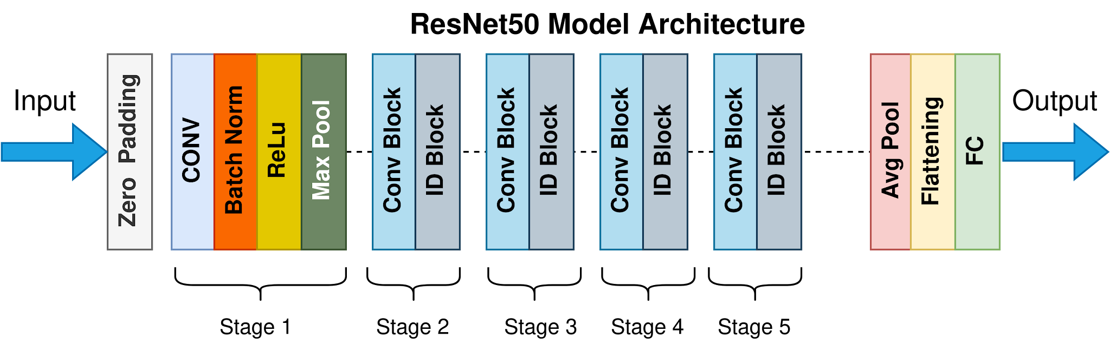
Model Used: ResNet50 (Transfer Learning)
Pretrained on ImageNet
Removed top layers and added:
Global Average Pooling
Fully connected dense layers
Final softmax layer with 7 outputs for 7 emotions
Why ResNet50?
Residual blocks handle deep architectures efficiently
Well-established in image feature extraction
Transfer learning allows faster training and less data dependency

Slide 9
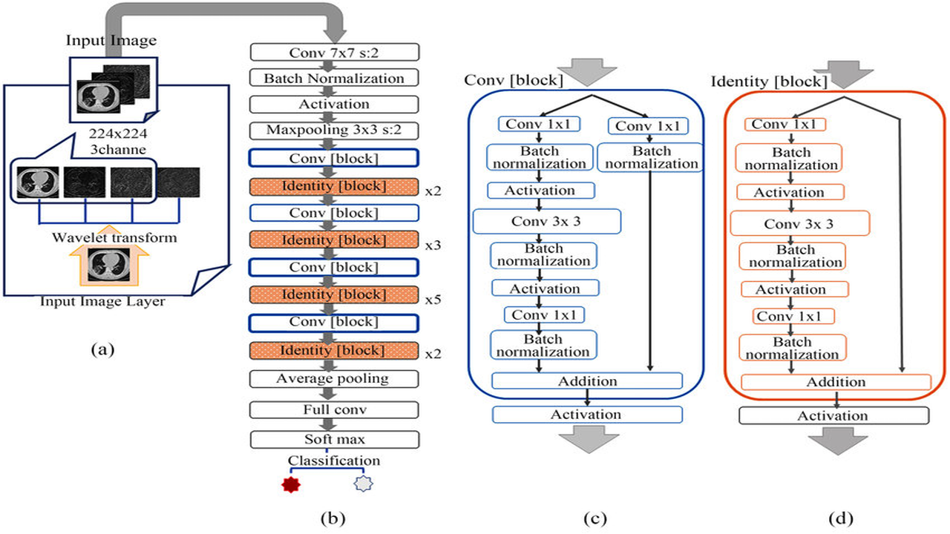
Model Architecture
Model Used: ResNet50 (Transfer Learning):
Pretrained on ImageNet.
Removed top layers and added:
- Global Average Pooling
- Fully connected dense layers
- Final softmax layer with 7 outputs for 7 emotions.
Why ResNet50?:
- Residual blocks handle deep architectures efficiently.
- Well-established in image feature extraction.
- Transfer learning allows faster training and less data dependency.

Slide 10
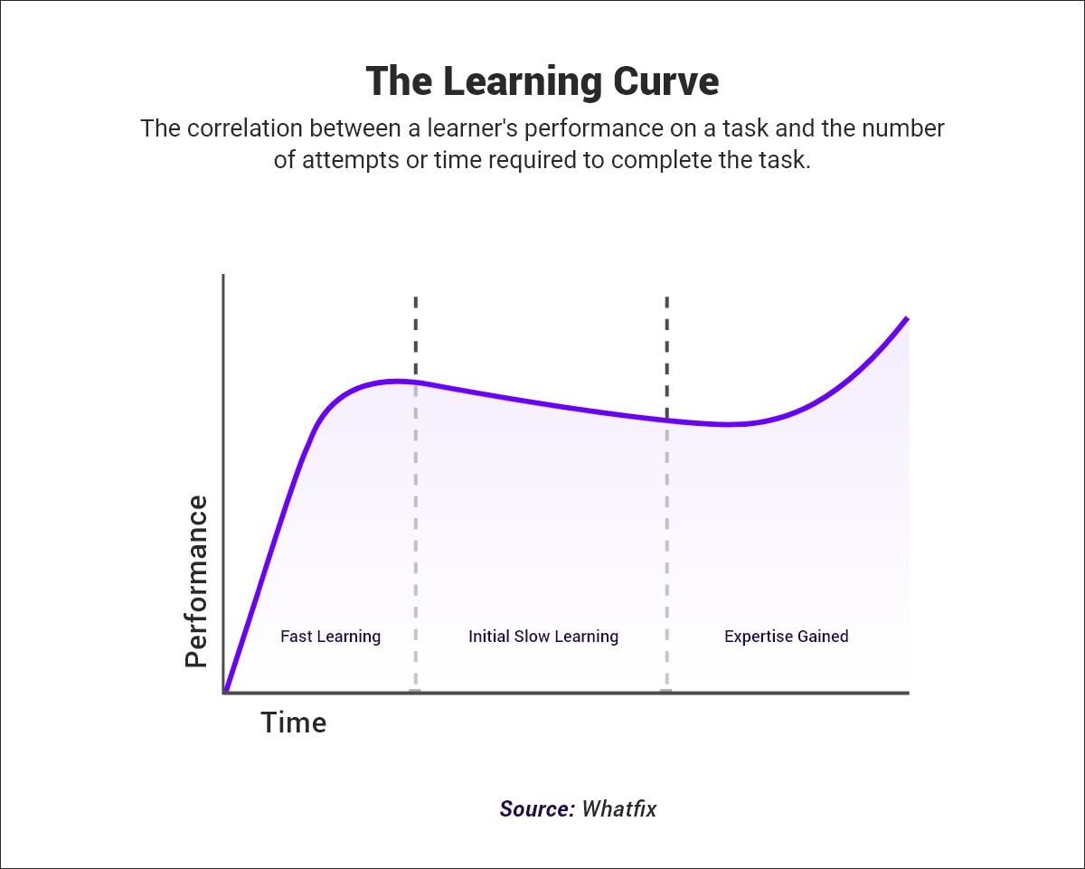
Training Configuration
Loss Function: Categorical Crossentropy
Optimizer: Adam
Metrics: Accuracy
Batch Size: [Refer from code, if available]
Epochs: [Insert actual value from notebook]
Training Curves:
Accuracy vs. Epochs
Loss vs. Epochs
Insight:
The model shows good convergence after a few epochs

Slide 11
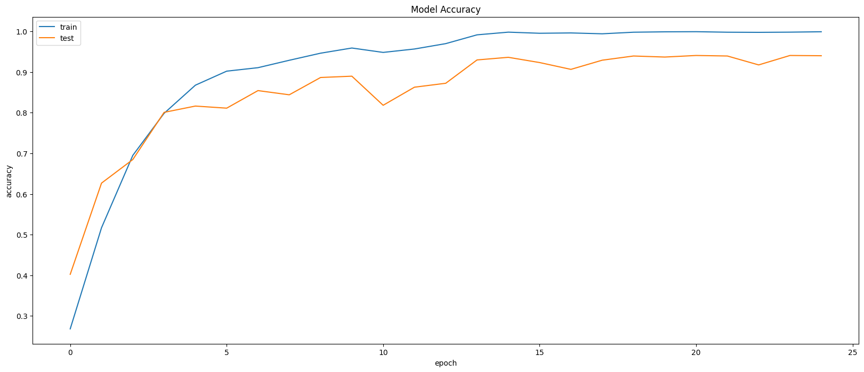
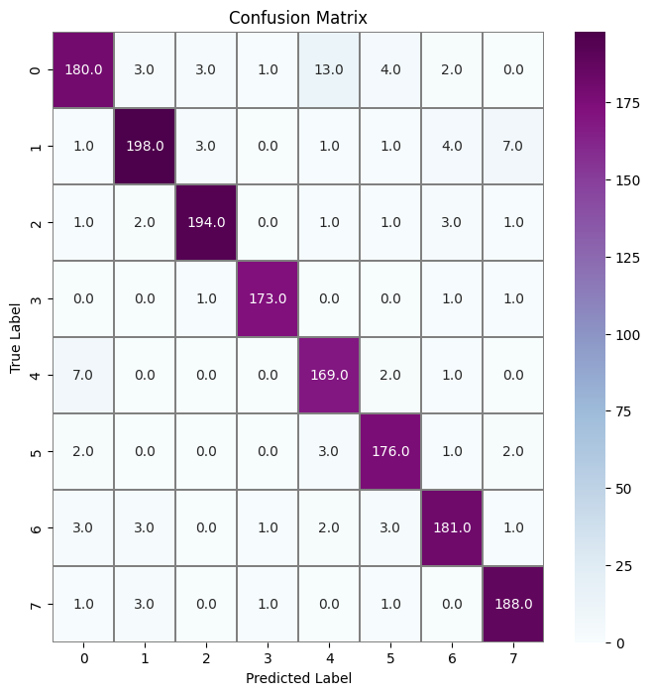
Evaluation Metrics

Slide 12
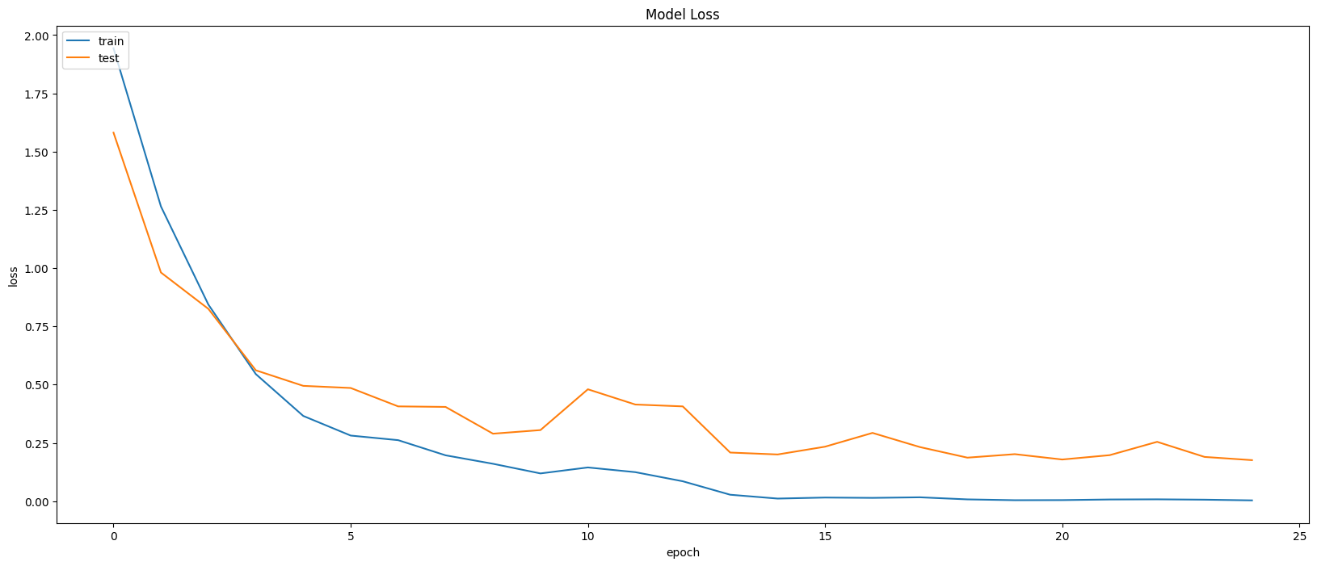
Evaluation
precision recall f1-score support
0 0.92 0.87 0.90 206
1 0.95 0.92 0.93 215
2 0.97 0.96 0.96 203
3 0.98 0.98 0.98 176
4 0.89 0.94 0.92 179
5 0.94 0.96 0.95 184
6 0.94 0.93 0.94 194
7 0.94 0.97 0.95 194
accuracy 0.94 1551
macro avg 0.94 0.94 0.94 1551
weighted avg 0.94 0.94 0.94 1551

Slide 13
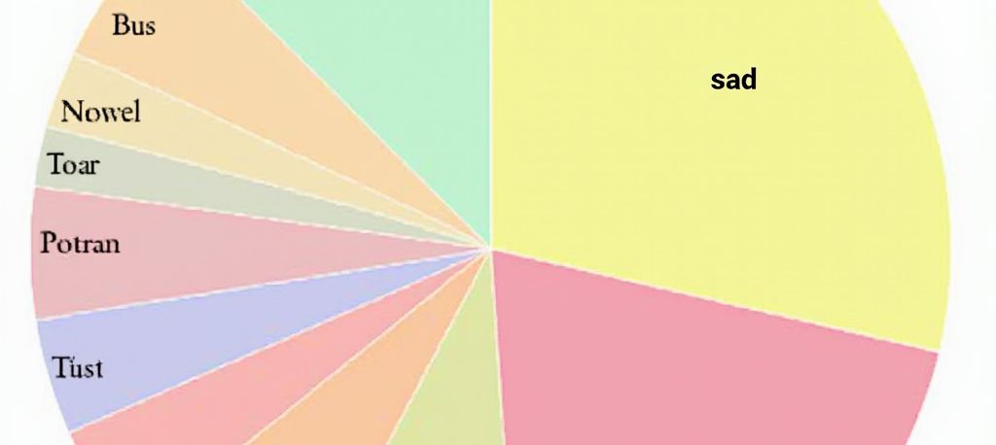
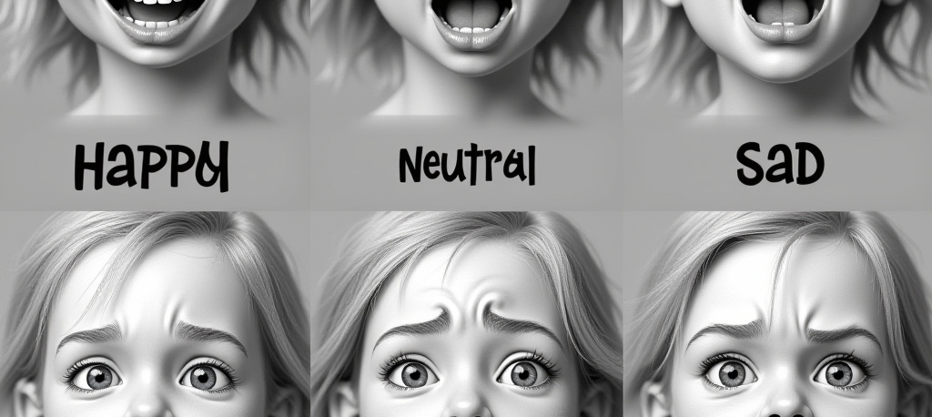
Exploratory Data Analysis (EDA)
Class Distribution and Imbalance
Sample Visuals and Insights
The Class Distribution (Pie Chart) shows some imbalance, with emotions like happy, neutral, and sad having more samples. The dataset is slightly skewed toward neutral and happy expressions.
Sample visuals include grayscale facial images per emotion category. An important insight is that emotions such as fear, disgust, and angry are often visually similar, posing a challenge for analysis.

Slide 14

Challenges Faced
If there's any paragraph that should go before the points, add it in this field
Grayscale data limits emotional detail.
Subtle facial differences between some emotions.
Slight class imbalance skewing predictions.
Hard to differentiate between neutral, sad, and fearful expressions in static images.

Slide 15
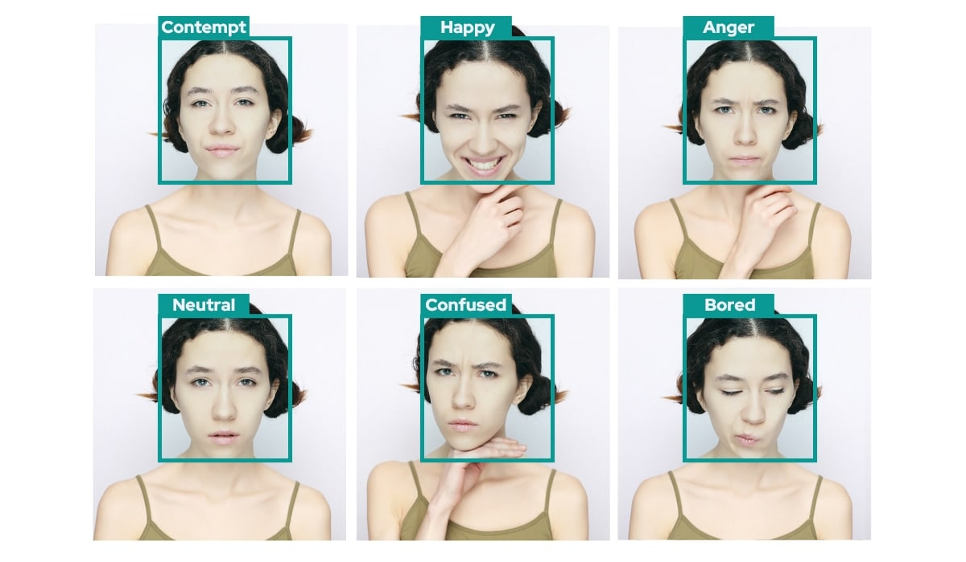
Conclusion
If there's any paragraph that should go before the points, add it in this field
Implemented an efficient facial emotion classification pipeline
Achieved reliable results using ResNet50
Demonstrated benefits of combining data preprocessing, augmentation, and transfer learning
Pipeline is extendable to larger datasets and real-world applications.

Slide 16
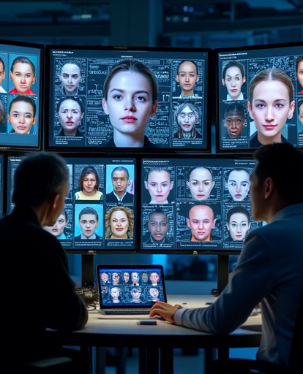
Future Work
Integrate with video frames for dynamic emotion recognition
Use colored facial datasets for richer emotional cues
Build ensemble models using EfficientNet, DenseNet, etc.
Apply attention mechanisms to focus on emotion-critical facial regions
Expand into multi-modal emotion recognition (voice + face).

Slide 17
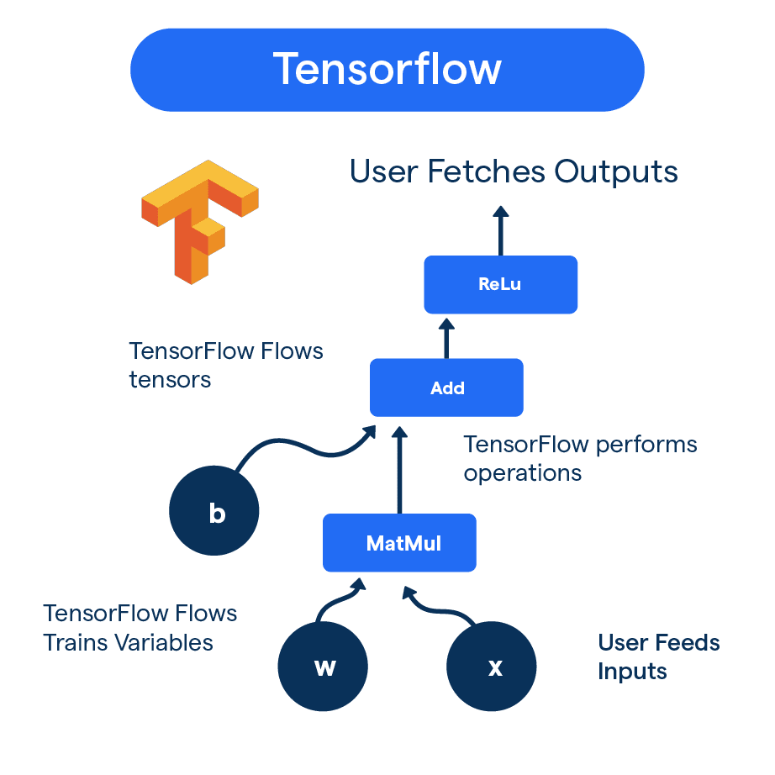
Implementation Requirements
Libraries Used:
TensorFlow / Keras
NumPy
Matplotlib / Seaborn
Scikit-learn (for evaluation metrics)
Hardware: GPU (NVIDIA Tesla T4 on Kaggle) 16GB RAM (Kaggle runtime)

